Slide 1
Used Car Price Prediction
Fadhiil Dzaki Mulyana

Slide 2
01
Business Understanding

Slide 3
Background
The automotive industry is one of the largest in the world, with the used car market playing a significant role. Understanding the factors that influence the pricing of used cars is crucial for various stakeholders, including buyers, sellers, and dealerships. Factors such as mileage, brand, model, count of previous owners, condition, ext. can all impact the price of a used car. Analyzing these factors through regression analysis can provide valuable insights into pricing trends and help stakeholders make informed decisions.

Slide 4
Goal
problem
create a robust regression model that accurately predicts the prices of used cars.
we dont know yet the best method that accurately estimates the price of used cars based on various attributes.
Use full for:
Objektive
Dealer
Car Entushiast
People who wants to buy a car
Data Visualization.
End-to-End Regression Project.
Hyperparameter tuning.

Slide 5
02
Used Cars Prices in UK Dataset

Slide 6
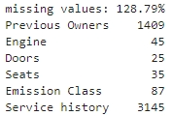
About Dataset
14 COLUMNS X 3685 ROWS
Unnamed: 0 | -
Title | Brand & Model
Price | Sale price (pounds.)
Mileage | Travelled distance (miles)
Registration year | officially registered year
Previous owners | Count of previous owners
Fuel type | Type of fuel used
Body type | General vehicle’s shape
Engine | Engine’s displacement
Gearbox | Transmission type
Doors | Count of doors
Seats | Seating capacity
Emission class | Standard emission (Euro)
Service history | Service completion
Used Car Prices in UK Dataset is a comprehensive collection of automotive information extracted from the popular automotive marketplace website, autotrader.co.uk. This dataset comprises 3,685 data points, each representing a unique vehicle listing, and includes thirteen distinct features providing valuable insights into the world of automobiles.
Automobile Dataset (kaggle.com)
Important Columns | Unsused Columns
Registration year Mileage Price | Unnamed: 0 Service history

Slide 7
03
Data Preprocessing

Slide 8
Preprocessing Step
01
02
03
04
05
Data Cleaning
Data Transformation
Feature Engineering
Feature Selection
Scaling

Slide 9


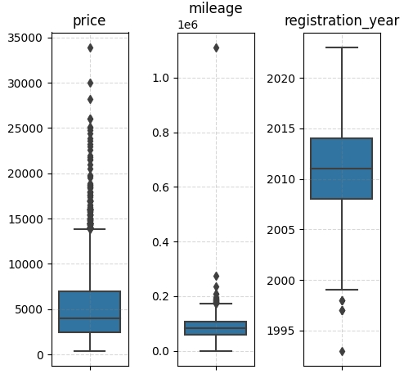
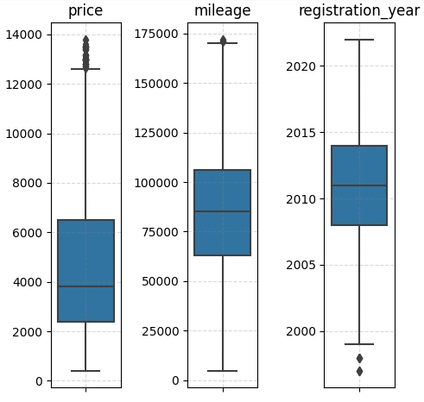
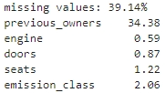


Data Cleaning
Unused Features
Duplicated Value
Drop service history and unnamed: 0 columns.
Drop duplicate
Outliers
Missing Value
Delete with IQR Method
dropna
KNN Imput

Slide 10
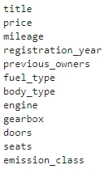


Feature Engineering & Data Transformation
New Features:
Regroup Fuel
Convert Dtype
Brand continent:
Extracted from Title feature.
Europe
Asia
North America
Before | After
Petrol | Petrol
Diesel | Diesel
Electric | Electric
Petrol Hybrid | Hybrid
Petrol Plug-in Hybrid
Diesel hybrid

Slide 11
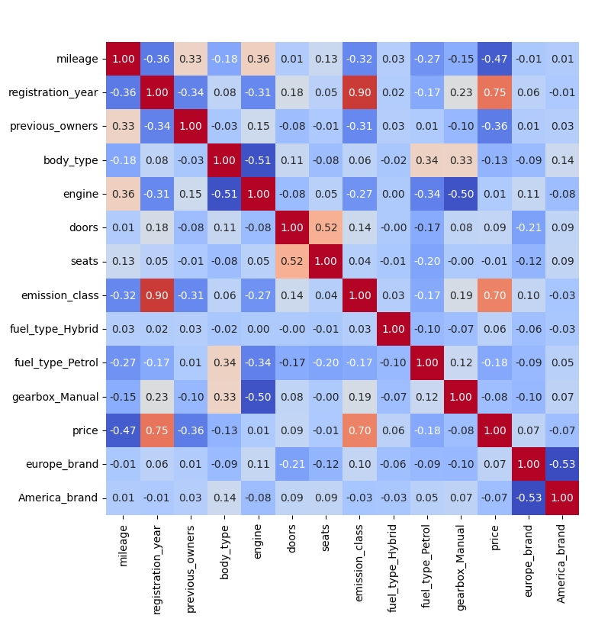
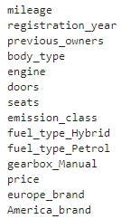

Feature Engineering & Data Transformation
Feature Selection
Categorical Encode
Registration year and emission class seems to have high VIF score, indicates multicollinearity.
Registration year has more correlation with the target than emission class.
Drop emisission class.
Labeling: 2 categories
One-hot: >2 categories
Count : >10 categories

Slide 12
03
EDA

Slide 13
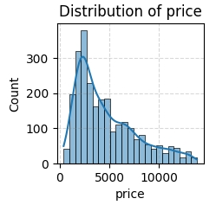
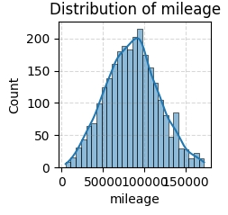
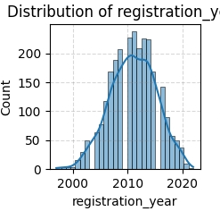
Continuous Features Distribution
Price
Mileage
Reg. Year
The majority of vehicles price are low, but there are very expensive vehicles in the market. There could be special demand for rare vehicles, which could drive their prices higher than average.
Most vehicles in the dataset have mileage values that are representative of typical usage patterns for vehicles of their type and age.
most vehicles were registered evenly across different years, without a significant bias towards any particular time period.

Slide 14
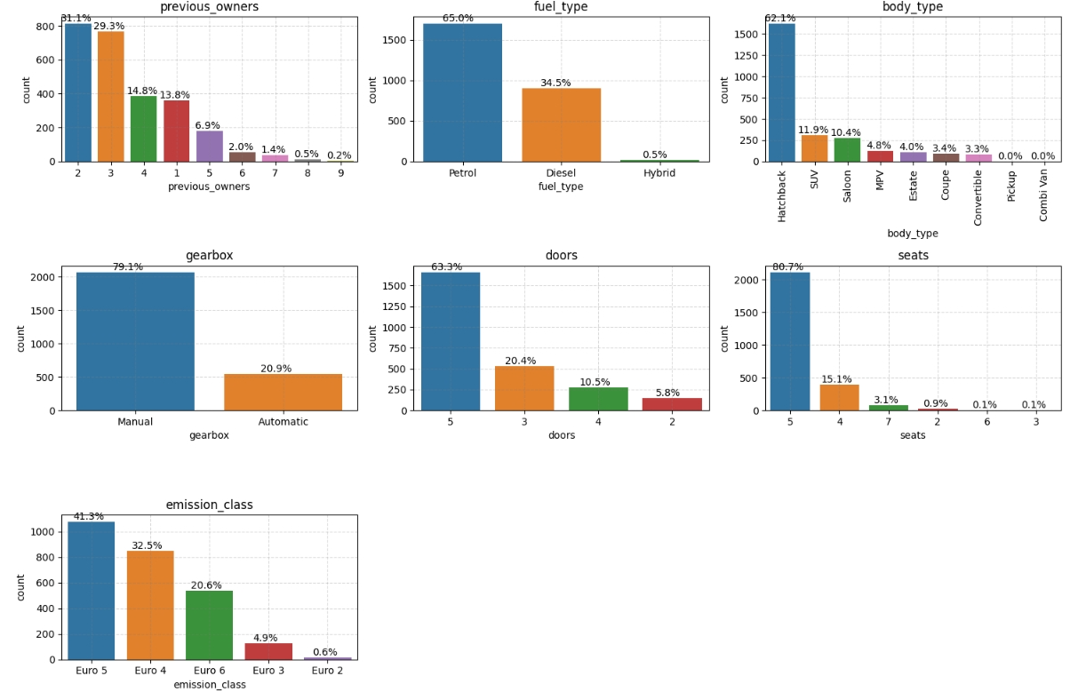
Categorical Features
Majority of features have imbalance distribution.
Certain categories have very few instances like Hybrid fuel type, other than hatchback, 5 seater, and/or 5 doors.

Slide 15
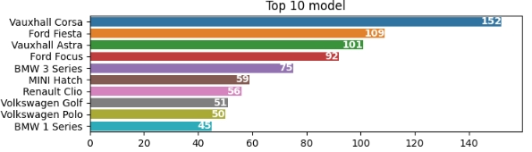
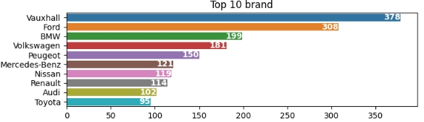
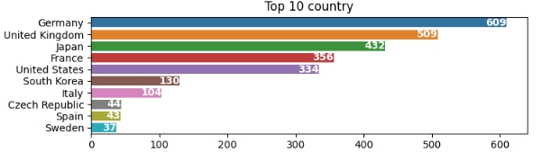
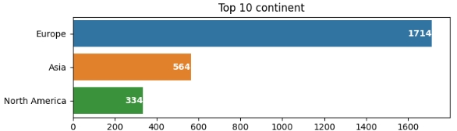
Title Extraction Features
The majority of vehicles are coming from Vauxhall with Corsa model.
The majority of brands are European, as 6 of the top 10 brand countries are in Europe.

Slide 16
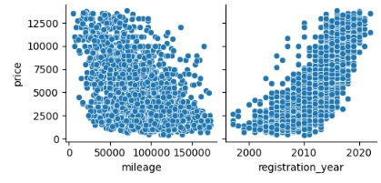
Price VS Continuous Features
VS mileage
VS Reg. Year
The further the distance travelled, the lower the price will be.
the newer the registration year, the higher the price will be.

Slide 17
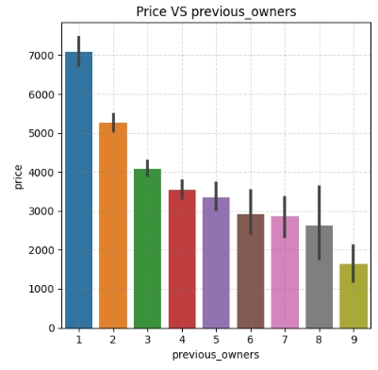
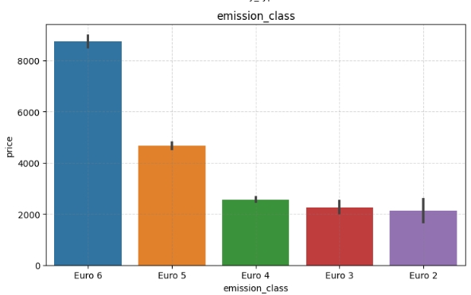
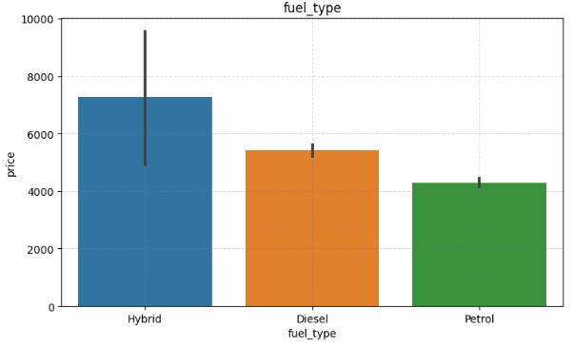
Price VS Categorical Features
VS Previous Owner
VS Emission Class
VS Fuel Type
The more owners there are, the lower the price will be.
The higher the emission standard of a vehicle, the higher the price.
This may be due to the strong correlation between model year and emissions class.
Ignoring Hybrid fuel, diesel vehicle has higher price than petrol.

Slide 18
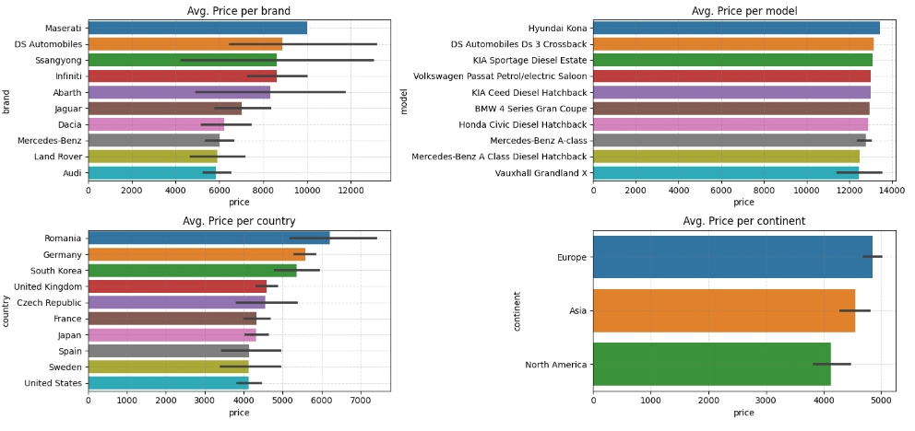
Title Extracted columns
The mosh expensive car in this dataset is Hyundai Kona, but Hyundai isn’t in top10 average brand price list. This may because Hyundai isn’t quite much and the price of other model is low.
Europe has the highest price average and 7 of europe brands are in the top 10 brands country average prices.
As you can see, model column has less outliers than the other title extaracted columns, but 469 unique value are there (too much).
Brand or country has less unique value than model, but there are too many outliers.
Brand continent is the more stable features, because it has only 3 unique, the outliers not as much as country or brand, and can represent title very well.

Slide 19
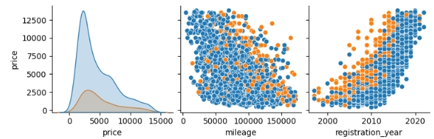
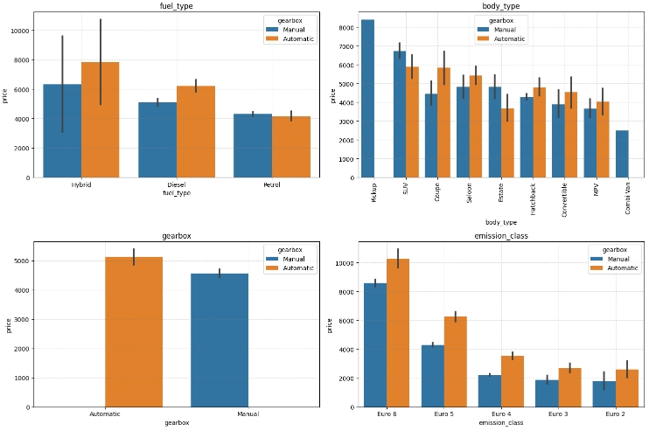
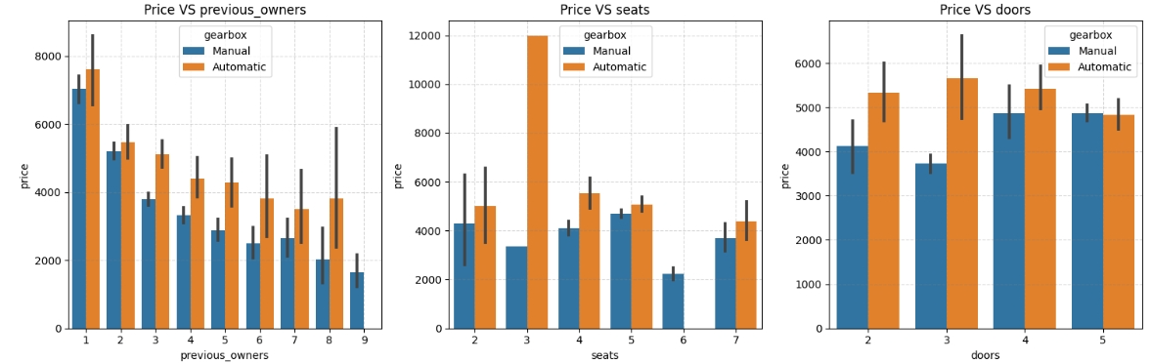
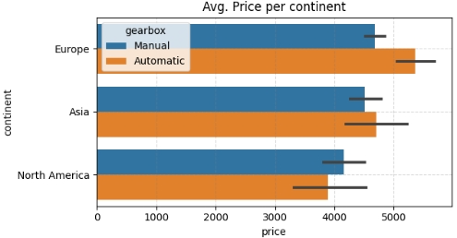

Take a look at these plots
These are plots separated by transmission type.
Distribution between manual and automatic price is the same,
Most of the plots shows that automatic transmission has higher price than manual.

Slide 20
05
Machine Learning

Slide 21
Model Building
Model | R2 |  | MAE |  | MSE
 | Train | Test | Train | Test | Train | Test
Linear | 0.739213 | 0.739583 | 1224.402536 | 1237.239468 | 2.455937e+06 | 2.415864e+06
Ridge | 0.739212 | 0.739580 | 1224.382666 | 1237.202174 | 2.455939e+06 | 2.415894e+06
Lasso | 0.739211 | 0.739553 | 1224.313579 | 1237.237101 | 2.455952e+06 | 2.416145e+06
ElasticNet | 0.661870 | 0.663136 | 1379.822427 | 1381.488873 | 3.184306e+06 | 3.125055e+06
Decision Tree | 0.999875 | 0.596637 | 1.385831 | 1381.013384 | 1.174466e+03 | 3.741965e+06
Random Forest | 0.972173 | 0.786783 | 369.142032 | 1074.890739 | 2.620548e+05 | 1.977993e+06
Gradient Boosting | 0.856403 | 0.813298 | 854.548768 | 1008.101459 | 1.352308e+06 | 1.732021e+06
Neural Network | -0.448340 | -0.422354 | 2954.646243 | 2889.601282 | 1.363959e+07 | 1.319506e+07

Slide 22
Choosing The Best Model
The Random Forest model has the highest test R2 (0.786783) and relatively low test MAE and test MSE compared to other models.
Decision Tree model has exceptionally high R2 on the training set (0.999875), but it doesn't generalize well on the test set.
Linear, Ridge, Lasso and ElasticNet have a stable score on test and train data for all metrics, but the score is very low.
Neural Network seems to perform the worst based on all metrics.
Gradient Boosting | 0.856403 | 0.813298 | 854.548768 | 1008.101459 | 1.352308e+06 | 1.732021e+06
Best Model
The Gradient Boosting model does indeed have strong performance, especially in terms of test R2 (0.813298). It also has relatively low test MAE and test MSE compared to many other models.
The Gradient Boosting model captures about 81.33% of the variability of the unseen data in the target variable, which is considered quite good.

Slide 23
Hyperparameter Tuning
Model | R2 |  | MAE |  | MSE
 | Train | Test | Train | Test | Train | Test
Gradient Boosting | 0.856403 | 0.813298 | 854.548768 | 1008.101459 | 1.352308e+06 | 1.732021e+06
Gradient Boosting (Tuned) | 0.889526 | 0.821414 | 762.330661 | 977.320034 | 1.040374e+06 | 1.656728e+06
Overall, hyperparameter tuning seems to have enhanced the Gradient Boosting model's performance.
The R2 score increased for both the training and test sets, indicating better model fit.
The MAE and MSE decreased, which suggests improved accuracy and precision in predictions.

Slide 24
06
Conclusion & Recommendation

Slide 25
Conclusion
Recomendation
Important Features: registration_year and mileage are the most important features to determine prices due to imbalance data in other features.
Vehicles with lower mileage, newer year, fewer owners, European brands, and/or automatic transmission are more likely to have a higher price.
Best model: Gradient Boosting Regressor with Hyperparameters. Accuracy increased, MAE and MSE decreased.
Note:
The available data may be incomplete or may not cover all factors that influence the price of used cars.
Utilize the insights gained from the prediction model to adjust pricing strategies for used cars.
Segment customers based on their preferences and predicted buying behavior using the insights from the prediction model.
Establish a feedback loop to continuously monitor the performance of the prediction model and incorporate new data or insights to improve its accuracy over time.
choose Vehicles with lower mileage, newer year, fewer owners, European brands, and/or automatic transmission to get more stable price.

Slide 26
ThakYou
linkedin.com/in/fadhiildzaki
https://github.com/FadhiilDzaki/used_car_price_prediction.git

